Slide 1
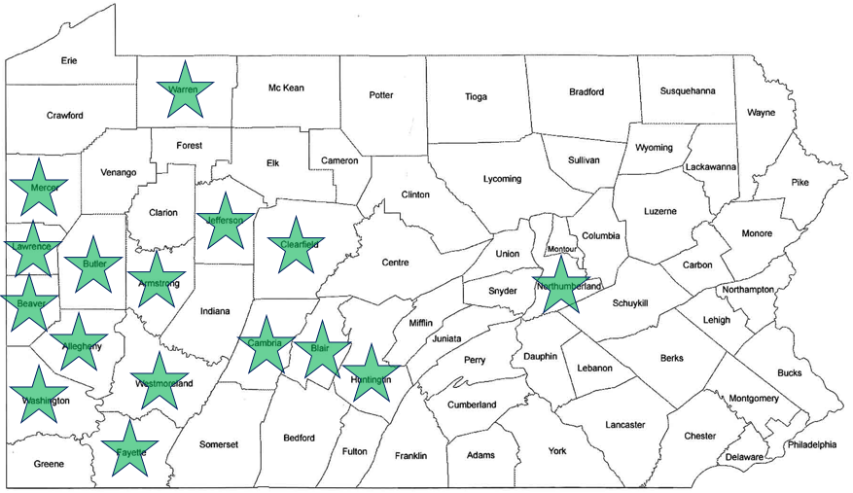
CARNEGIE MUSEUM OF NATURAL HISTORY Education Outreach
Chelsey Pucka, Assistant Director Education & Visitor Experience
Pam Keiper, Outreach Program Manager

Slide 2
What we do
Carnegie Museum of Natural History Outreach is centered upon shared exploration of nature – using evidence to anchor, reinforce, and re-interpret our understanding of life on earth.
Through collaborations with diverse learners and broader communities, we create an active, inclusive, science learning environment that captures the imagination and helps people understand how science is vital to our lives and society.

Slide 3
Where we connect
Women and Children Shelters
Private, Public and Exceptional Schools
Mental and Physical Health Hospitals
Community Organizations
Senior Citizens Centers
16 Pennsylvania counties served

Slide 4
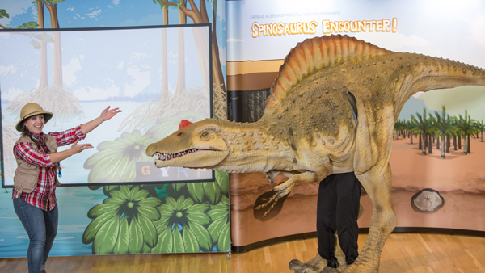
Yearly Impact
51,844
2,000
Programs annually
People Served

Slide 5
How we connect
Classroom visits
Distance Learning
Large Assemblies
Community gatherings
Education Loan Collection

Slide 6
Carnegie Museum of Natural History increases scientific and public understanding of the natural world and human cultures.

Slide 7
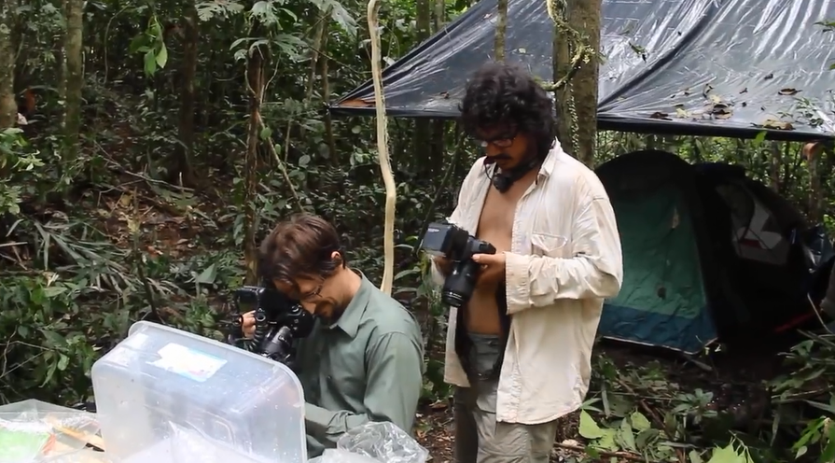

Slide 8
.

Slide 9
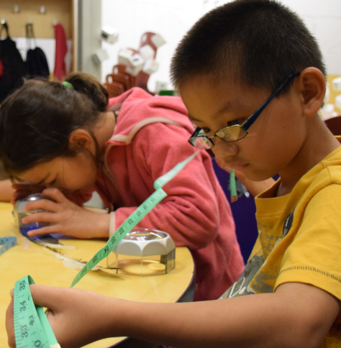

Slide 10
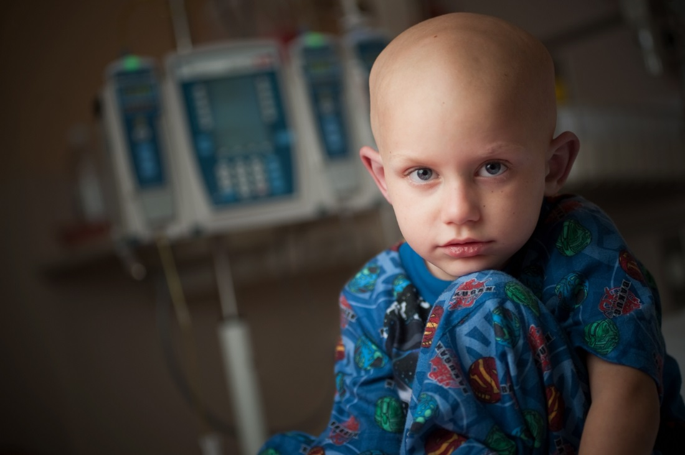

Slide 11
Community feedback
At this time, I’d like to share a couple of anecdotes with you. Enrolled in my program is a child with special needs. “Mary” is mostly nonverbal, using an iPad to communicate. When the “Museum on the Move” brought butterflies to our classroom, Mary could not stop talking about them. We learned colors and shapes. We counted and classified butterflies. What was brought into the classroom facilitated her communication and opened a whole new avenue for us to reach her. The effects of that visit were far more reaching than just the 30 minutes the educators in the classroom.
Peg Baycer
Children’s Center for Creative Learning

Slide 12
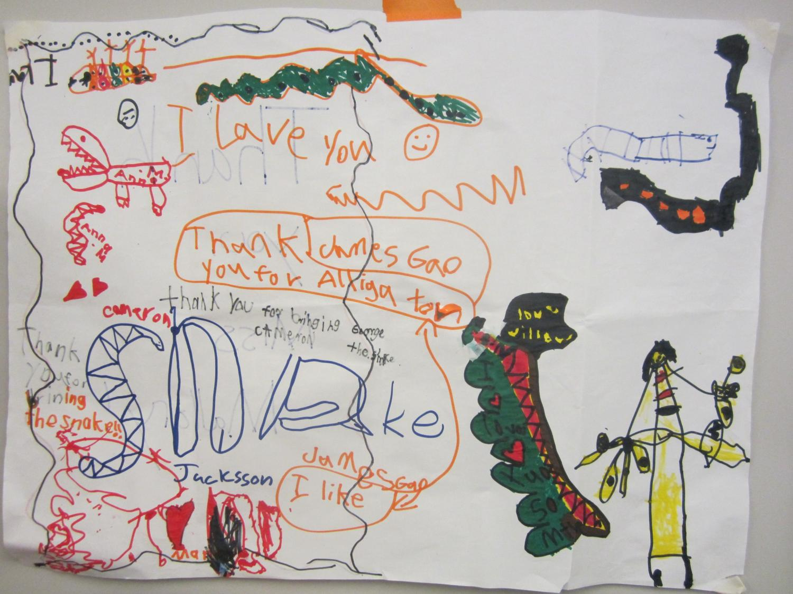
Children’s feedback

Slide 13
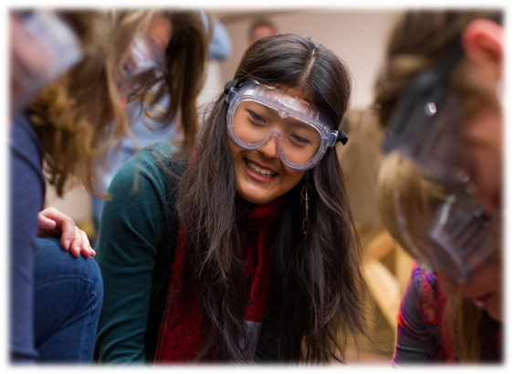
Outreach Educator feedback
I know I truly do make a difference when I visit my schools each month, and it's not just the kids who look forward to my visits, I look forward to teaching them new things and bringing them new artifacts to examine. Visiting the MOM sites so often is unique because I see how much the kids are growing and learning as the year goes on, and how their knowledge of the natural world expands.
Alexandra OBlock
Carnegie Museum of Natural History Full Time Educator

Slide 14
