Slide 1
Pennsylvania Legislative Arts & Culture Caucus
September 30, 2015

Slide 2
The Pennsylvania Humanities Council is the primary champion of the humanities in Pennsylvania.
We connect Pennsylvanians to each other through stories, ideas, and experiences that can change lives and transform communities.

Slide 3
Pennsylvania has a crucial need for humanities-based afterschool programs.
More than half of school-age children in Pennsylvania live in poverty.
Nationally the academic achievement gap between students from lower- and higher-income families has grown 40% in 30 years.
The student achievement gap in Pennsylvania is among the widest in the nation.

Slide 4
The achievement gap has a drastic effect on Pennsylvania’s economy and its workforce.
Estimated annual cost of $1 billion to $3 billion in lost earnings.
Potential gain of $5.1 billion in lifetime earnings if the achievement gap were addressed.

Slide 5
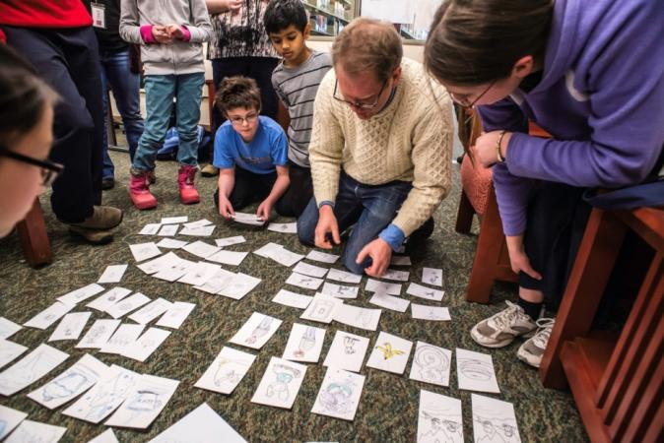
Youth who participate in quality afterschool programs have
Better academic
outcomes.
Better school
attendance.
Lower incidence
of experimenting
with drugs and alcohol.

Slide 6
Yet more than half a million children in Pennsylvania need, but don’t have, quality afterschool programs.
Teens in particular are often overlooked.
We can do better!

Slide 7
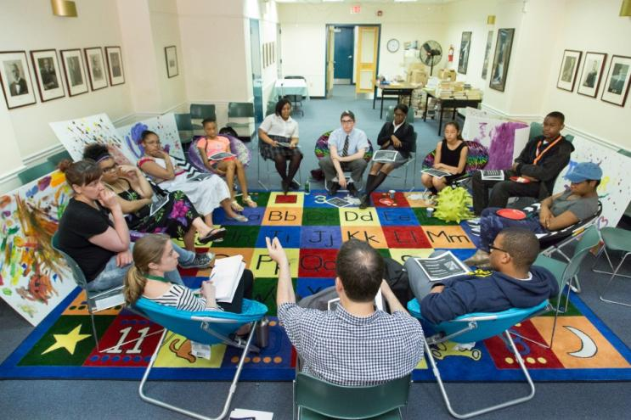
Investing in quality afterschool programs promises a great return on investment:
An improved
economy.
A better education
for our children—
and our future
workforce.

Slide 8
Pennsylvania teens need quality afterschool programs.
The humanities help teens build critical-thinking and problem-solving skills.

Slide 9
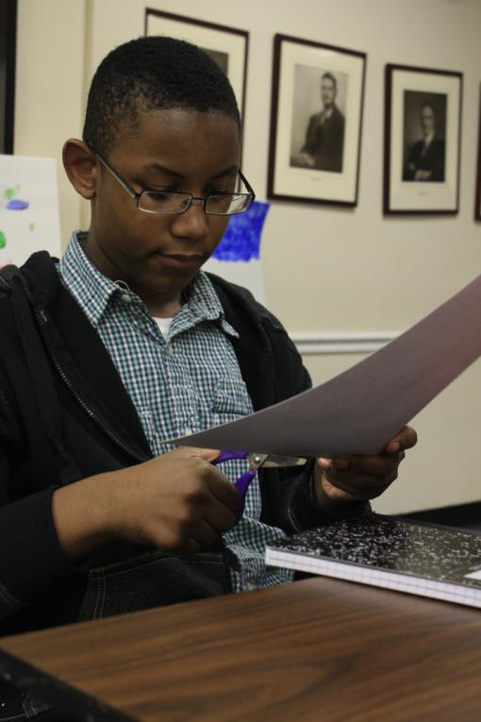
Free Library of Philadelphia— Philadelphia City Institute

Slide 10
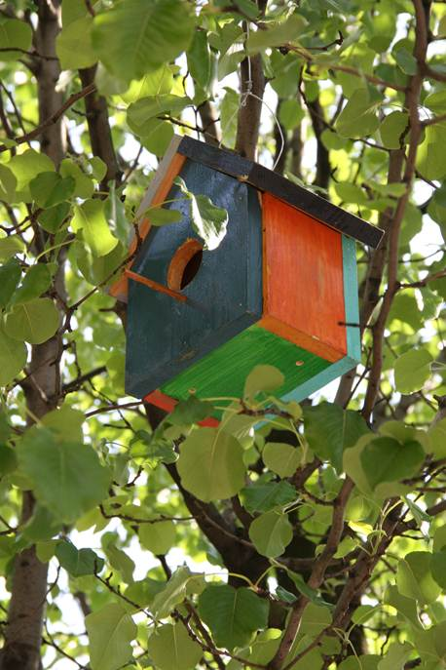
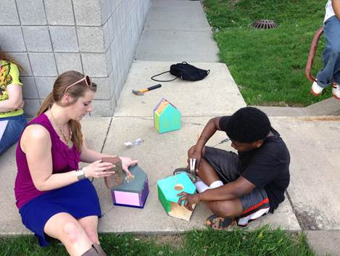
Carnegie Library of Pittsburgh—Hazelwood

Slide 11
8 in 10 participants felt more confident
Participating in discussions and activities.
Expressing thoughts and feelings to others.
Understanding others’ viewpoints.
Forming friendships.

Slide 12
90 percent of participants say
They would go to the library to hang out.
Recommend that their friends visit.
Assist library staff in developing new programs.

Slide 13
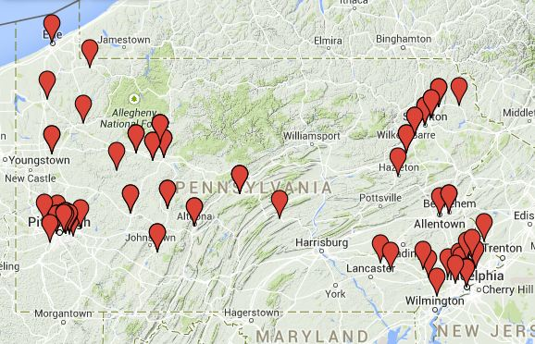
57 libraries and more than 400 teenagers have participated in Teen Reading Lounge to date.

Slide 14
In 2016 we will launch a Teen Reading Lounge low-income pilot program.
Half of all the Teen Reading Lounges we launch that year will be in low-income areas.

Slide 15
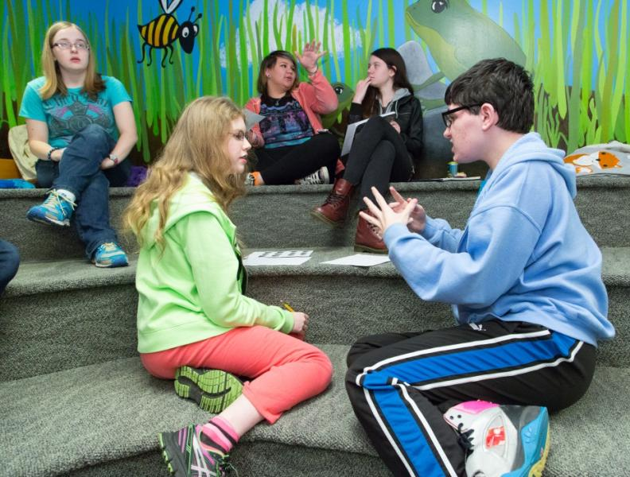
An investment in quality afterschool programs like Teen Reading Lounge offers a clear return on investment.

Slide 16
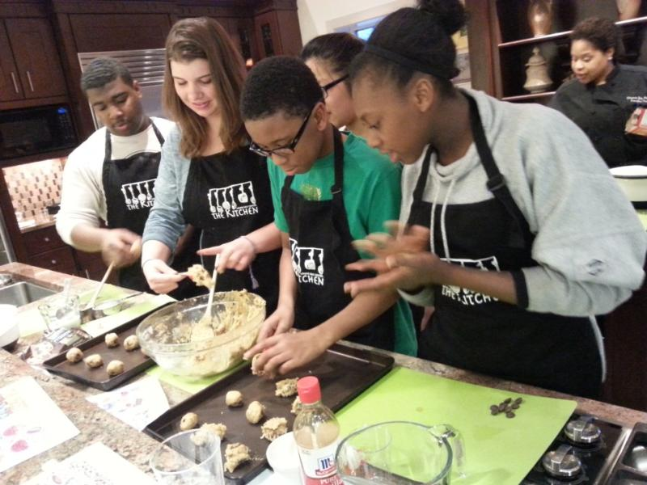
Help Pennsylvania teens become engaged citizens in their communities and productive members of the workforce.

Slide 17
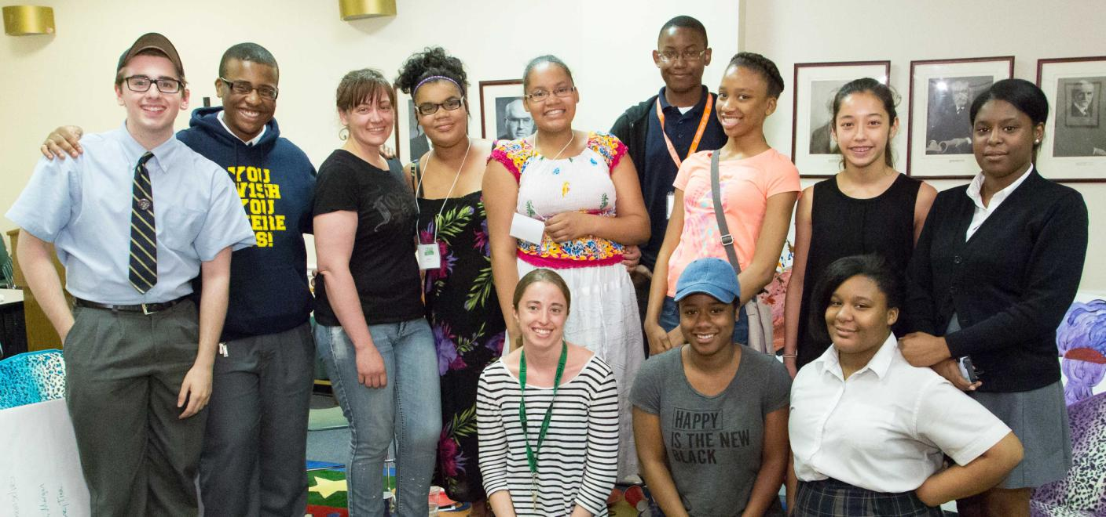
Thank you.

Slide 18
`
Connect with us!
Learn more at pahumanities.org

